Slide 1

Social Determinants of Women’s Health
11-12 September, 2019
Hoda Rashad
Social Research Center
The American University in Cairo
PRESENTATION OUTLINE
New Conceptualization of Social Determinants of Women's Health
Study Results
Policies and Recommendations
Citation:
Rashad, H. (2019, September 11-12). Social Determinants of Women’s Health [PowerPoint presentation]. First Arab Conference on “Women's Health: Promoting Women's Health to Achieve the 2030 Agenda for Sustainable Development”, Cairo, Egypt.

Slide 2
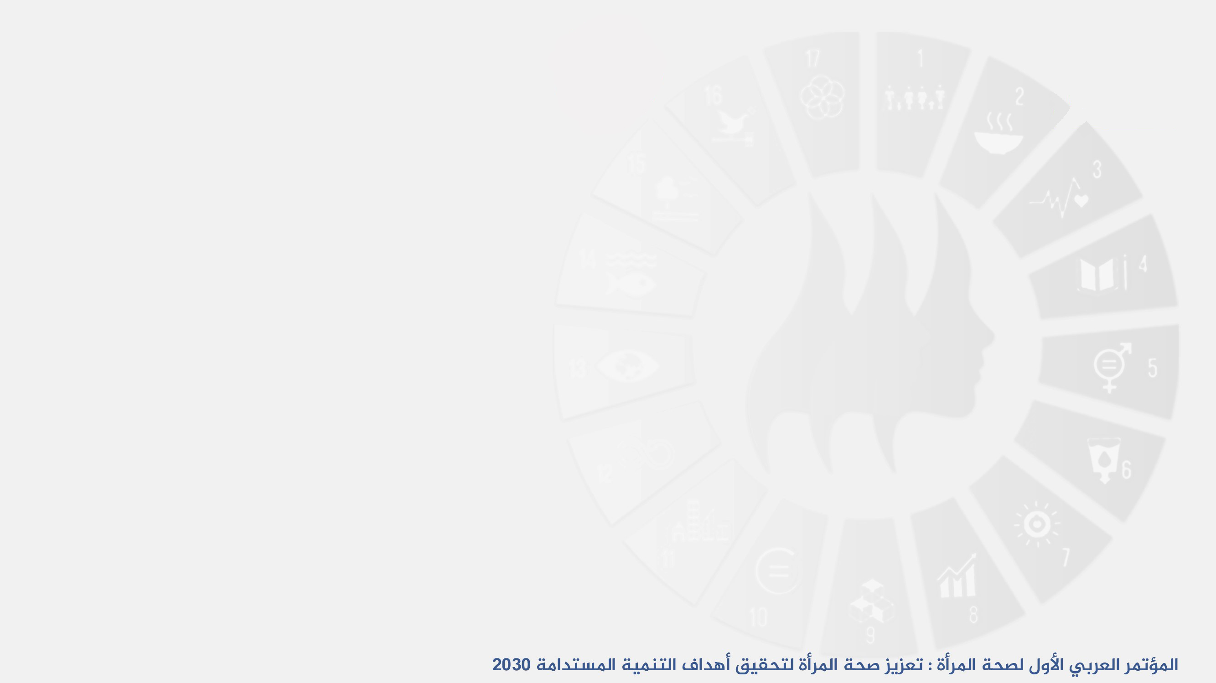
I. NEW Conceptualization OF SOCIAL DETERMINANTS OF WOMEN'S HEALTH
1. Women’s Health
A Measure of Fairness of Social Arrangements + Level of Country’s Progress
Not just a health challenge
WHO 46¹, ICPD 94², MDG2000³, SDG2015⁴
2. Definition of the Social Determinants
From Proximate Determinants to Public Policies
(CSDH 2008⁵: “Causes of the Causes”)
3. Differences in Health Status between Social Groups
INEQUALITY INEQUITY
Systematic Differences that are Unnecessary and Unjustified
Are UNFAIR

Slide 3
II. STUDY RESULTS
Women's Reproductive Health Measures
A wide range of health challenges (impact indicators) as well as a range of social risks (outcome indicators), closely anchored on gender relations and women's status in society
Disparities in Women's Reproductive Health
An indicator that reflects the unfair governance, inequity in the society, and the failure of public policies
Directly Related Sustainable Development Goals and Targets
Reproductive Health G3,T3.1,T3.2, T3.3, T3.7
Gender G5 , All targets
Inequity and containment G16, T16.3, G4, T6.1, T6.2, T9.1, T16.8
Distribution of all other social determinants related to physical, mental and social health (poverty, education, geographic distribution, power relations in society, citizenship rights (refugees, ethnic differences, religion .....))

Slide 4
II. STUDY RESULTS
1. Study
2. Research Team
Develop and apply the conceptual framework of social determinants of health to reproductive health data
The Social Research Center of the American University in Cairo (AUC) as an implementing partner of the United Nations Population Fund (UNFPA) Arab States in cooperation with national authorities in five Arab countries and a group of independent researchers
Conceptual Framing | Operationalizing the Theoretical Framework |  |  | Tracing Inequities | Call for Action
Adapting | Articulating the indicators | Selecting Stratifications | Choosing measures | Assessing fairness | Guiding policies and actions
Social Determinants of SRH Multi level frame Inequity | Impact indicators Outcome (risk factor) indicators Health system capacity indicators Health system performance indicators | Administrative/ geographic location Wealth Gender norms | Index of dissimilarity expressed in percent Concentration index redistribution need expressed in percent | The structural determinants Distribution of intermediary determinants | Sectoral Policies Governance + Enabling actors
Sources: EDHS 2005,2014 – JPFHS 2007, 2012- MENPSF 2011- ORHS2008 – SMICS 2014

Slide 5
II. STUDY RESULTS
Selected examples of study results
Progress in physical health + some aspects of the health system
Social challenges persist
High level of disparities between social groups
Progress in health levels is not accompanied by a reduction in inequality but by an increase in inequality in some cases
The distribution of the gender indicator has a noticeable effect on the distribution of health. The distribution is linked to the local culture but feeds on deprivation (poverty, ignorance, lack of capacity ...)
Inequity in the health system. Not responsive to the varying challenges but also is less responsive to higher needs.
Weak data and methodologies available to document the decentralization of justice in governance and policies + many features and indicators of injustice.

Slide 6
1- Severity of Social Challenges | 1- حدة التحديات الاجتماعية
 | Egypt | Jordan | Morocco | Oman | Sudan
 | 2014&15 | 2012 | 2011 | 2008 | 2014
Female genital cutting (1-14 years) الختان | 14.1 |  |  |  | 31.5
Consanguinity زواج الأقارب | 31.5 | 34.6 | 28.8
Adolescent childbearing (15-19) انجاب المراهقات | 10.9 | 4.5 | 6 | 1.2 | 15.1
Multiparity (5+ children) انجاب مرتفع | 13.0 | 31.7 | 18.7 | 43.7 | 39.8
Marital violence العنف الزوجي | 30.3 | 31.7
Marital physical violence during pregnancy العنف الزوجى خلال الحمل | 6.6 | 7
2- Geographic Index of Dissimilarity | 2- مؤشر (Index of dissimilarity) مرتفع للتفاوتات الجغرافية
 | Egypt | Jordan | Morocco | Oman | Sudan
 | 2014&15 | 2012 | 2011 | 2008 | 2014
Infant mortality وفيات الاطفال | 11.4 | 4.8 | 19.6 |  | 9.7
HBV infection in females (1-59 years) الإصابة بالالتهاب الكبدى الفيروسى ب بين النساء (1-59 سنة) | 15.4
Female genital cutting (1-14 years) الختان | 17.3 |  |  |  | 27.2
Adolescent childbearing (15-19)انجاب المراهقات | 19.5 | 3.9 | 19.0 |  | 6.9
Multiparity (5+ children) انجاب مرتفع | 23.5 | 2.0 | 10.3 |  | 6.5
Marital violence العنف الزوجي | 3.0 | 1.8

Slide 7
3- Improvement in Health ≠ Reduction in Inequalities | 3- التقدم عبر الزمن لا يعنى التقدم في عدم المساواة، بل قد يصاحبه ارتفاع
مستويات إنجاب المراهقات حسب المناطق الجغرافية ومؤشر عدم المساواة الجغرافية(ID%)
Level of Adolescent childbearing by geographic classification and index of dissimilarity
4- Gender Norms influences health dist. | 4- تأثير توزيع النوع الاجتماعى على توزيع الصحة
مؤشر عدم التساوى (مؤشر التركيز) في الصحة حسب تقسيم فئات النوع الاجتماعى
Index of Concentration by Dist. Of Gender Norms
 | Egypt | Jordan | Morocco | Oman | Sudan
 | 2014&15 | 2012 | 2011 | 2008 | 2014
Infant mortality وفيات الاطفال | 10.3 | 1.9 |  |  | 8.2
HBV infection in females (1-59 years) الإصابة بالالتهاب الكبدى الفيروسى ب بين النساء (1-59 سنة) | 2.1
Female genital cutting (1-14 years) الختان | 16.5 |  |  |  | 4.1
Adolescent childbearing (15-19) انجاب المراهقات | 15.6 |  |  |  | 11.9
Multiparity (5+ children) انجاب مرتفع | 20.9 | 1.9 |  |  | 6.0
Marital violence العنف الزوجي | 2.4 | 2.3

Slide 8
Unfairness of Health system: Not Responsive to Wealth Inequalities | عدم الإنصاف في النظام الصحى: عدم استجابته للتفاوتات في الثروة
مؤشر التفاوتات (Concentration Index) حسب توزيع الثروة
Concentration Index by Wealth
Health system performance أداء النظام الصحى | Egypt | Jordan | Morocco | Oman | Sudan
 | 2014&15 | 2012 | 2011 | 2008 | 2014
No antenatal care (≤ one visit) عدم رعاية الحمل | 17.9 | 35.2 | 31.9 | 1.3 | 24.4
Home deliveryالولادات بالمنزل | 25.4 | 28.8 | 31.1 | 4.4 | 11.2
Caesarean section deliveryالولادة القيصرية | 8.4 | 4.0 | 26.6 |  | 32.2
No HIV/ AIDS comprehensive knowledge in females HIV/AIDS عدم المعرفة | 1.3 | 1.9 | 34.0 |  | 3.1
Health system capacity قدرة النظام الصحي
Distant healthcare facility البعد عن الوحدة الصحية | 10.8 | 8.6 | 24.6
Unavailable provider عدم وجود مقدم خدمة صحية | 4.2
مستوى ومؤشر عدم المساواة الجغرافية الاردن Level and Index of Geographic Inequalities

Slide 9
III. POLICIES AND RECOMMENDATIONS
Call to address inequities in the distribution of reproductive health
Requirements
Put reproductive health inequalities at the forefront as a measure of justice and social success
Adopting a reform movement of social policies
Rationale for action
Positive opportunities for success of the current development efforts in the Arab world and development commitments (ICPD, SDGs) and progress in some health aspects - despite the political challenges and risks of terrorism and extremism - and recognizing the importance of women’s health and the need not to exclude anyone.
(SRH + Leaving NO ONE BEHIND)

Slide 10
Rational for Action (continued)
The severity of inequalities and their relation with inequitable social arrangements and inequities in public policies
FROM INEQUALITY
TO
INEQUITY
Expected class differences require relieving the burden, a humanitarian perspective
(Human Rights)
Differences due to unfair policies demand
addressing injustice and reforming policies
(Social justice, good governance, Ethical Imperative)

Slide 11
III. POLICIES AND RECOMMENDAT
Recommendations for the social health and social sectors
Complete the work on SRH
Integrate a justice lens into services and performance evaluation
Address inequalities in women's health through intersectoral initiatives and programs
Ensure the responsibility of social sectors for health inequalities (The Stewardship Role of the Health Sector, HEIA, HEIA)
Move the civil society and academia from demanding change to participating in change
Recommendations for governance and public policies
Justice, Equity and Equality: Pillars of Good Governance
Adopt health equity as a measure of good governance, progress, and community justice
Determine Liability and Institutional Accountability for Unfair Inequalities (HEiAP)
  Adoption of policies: Requires measuring the fairness of the impact of policies on health of social groups
  HE Impact Assessment

Slide 12
III. POLICIES AND RECOMMENDAT
Enabling Factors
An integrated health information system for measuring disparities, monitoring and linking them to policies.
Support for research and analytical capacity to support equitable health policies.
Awareness of Policy makers of the risks of inequity on the stability of society and support to decision-making capacities
Expand participation opportunities
Build community demand that recognizes the importance of equity and its link to health

Slide 13
REFERENCES
WHO (World Health Organization). International Health Conference, New York, N. Y., June 19-July 22, 1946.
UNFPA (United Nations Population Fund). Programme of Action Adopted at the International Conference on Population and Development; 1994 September 5-13; Cairo, Egypt. United Nations Population Fund, New York; 2004.
United Nations. Indicators for monitoring the millennium development goals; 2003.
United Nations. Transforming our world: The 2030 Agenda for sustainable development. A/RES/70/1; 2015.
CSDH (Commission on Social Determinants of Health). Closing the gap in a generation: Health equity through action on the social determinants of health. Final report of the commission on social determinants of health. Geneva, Switzerland: World Health Organization; 2008.
Rashad H, Shawky S, Khadr Z. Reproductive health equity in the Arab region: Fairness and social success. Regional Study; The Social Research Center, The American University in Cairo, UNFPA/ASRO; Forthcoming.
Rashad H, Khadr Z, Shawky S. Reproductive health equity in the Arab region: A call for action. Policy Brief; The Social Research Center, The American University in Cairo, UNFPA/ASRO; Forthcoming.

