Slide 1
FIRST WORKSHOP ON “HEALTH SYSTEMS STRENGTHENING FOR MONITORING HEALTH IN THE SUSTAINABLE DEVELOPMENT AGENDA” 16-18 September, 2018 Cairo, Egypt
Health Equity Framework
Hoda Rashad
Citation:
Rashad, H. (2023, September 16-18). Health Equity Framework [PowerPoint presentation]. Workshop on “Health Systems Strengthening for Monitoring Health in the Sustainable Development Agenda”, Cairo, Egypt.

Slide 2
Framework of Health Inequity
Objective:
To appreciate the importance of measuring inequity and how the framework of Health Inequity can guide investigation of inequity and recommendation of policies.

Slide 3
Content
Introduce the many shifts in development thinking
Clarify the difference between inequality and inequity.
Introduce the framework of health inequity (reflecting I +II)
Show the relevance of framework in:
The analysis of inequity.
Drawing policy implications.
V. Urgency of action on health inequity in the Arab region

Slide 4
Opening Questions:
How to improve health in your country?
What is meaning of SDH?

Slide 5
SDH: History
Social Determination of health (historic evolution)
Health is a social phenomenon
Alma Atta (1978)
SDH articulated in Alma Atta
PHC: focus on Com.+ behaviour changes + mention of
general policies.

Slide 6
SDH: History
Implementations:
Medical model + socially sensitive + behaviour
Health is usually treated as a personal issue, emphasizing the modification of individual behavior and choice, without the link that reveals systemic patterns associated with social conditions. This encourages remedial actions focusing on changing individual behavior and life styles rather than social transformations.

Slide 7
SDH: History
For example, the focus on education of mothers and their influence on children health has always emphasized the behavioral mechanism linking education to child health.
As a result, health policies tended to adopt simplistic ineffective strategies for behavioral changes. Such strategies did not recognize the contextual constraints that impede behavioral change and have not paid the needed attention to enabling environments and structural forces.
Changing behaviours change conditions we live in (healthy Choices, Easy Choices)

Slide 8
I. Shifts
Shift 1: From proximate determinants to structural determinants
Human rights: Responsibility of the state
Moral rational
Shift 2: Health in all policies (HiAP)
Rationale HiAP Social policies hold enormous benefits to the well being of individuals. There are studies on industrialized countries that documented as much as 50% impact of social conditions on health status with health care impacting only a much smaller share of our health.

Slide 9
1. What is the Meaning of HiAP
“Health in All Policies (HiAP) is a policy principle to improve population health, addressing factors that reside outside the health system and in policy sectors other than health (Sihto, Ollila & Koivusalo, 2006)”.

Slide 10
Shifts
Shift 3: From physical ill health to health and well being
WHO, def: Beyond Physical health
Focus: Mortality and disease
Lend themselves more to medical interventions
More recently:
“It is the Duty of the Government to Create the Adequate
Environment for the Happiness of Individual, Families and Employees”
Sheikh Mohamed Bin Rashed
UN General Assembly has invited Member States to “Pursue the elaboration of additional measures that better capture the importance of the pursuit of happiness and well-being in development with a view to guide their public policies” (UN, 2011, P.1)

Slide 11
I) Shifts & SDG
SDG Capture these shifts:
Link between health and other goals (SDH, HiAP, ISA)
Well being as a goal and outcome measures of SDG.
Responsibility of the state: inclusive strong institutions.

Slide 12
Shift 4: Leaving no one behind: Concern with inequality
MDG: Achievements but Uneven and Unfair Dist. of Gains
SDG: Universal, for All
SDG3: “ensure healthy lives and promote well being FOR ALL”
SDG5: “achieve gender equality and empower ALL WOMEN AND GIRLS”
SDG10: reducing inequalities within and among countries

Slide 13
The human right movement provided the Moral Rationale for the duty of the state and communities to prevent the extra health sufferings whenever feasible. The focus on proximate SDH and the Moral Obligation couched the whole discourse in a social development discourse constrained by the available economic resources and ineffective health system policies. Improvements in health alongside socioeconomic progress convinced policy actors that the combination of effective socioeconomic policies (development in general)(1) (and targeting)(2) (as well as increasing financing of health system and its efficiency)(3) is indeed the right way ahead.

Slide 14
Shift 5: From inequality to inequity
II. Difference bet. Inequality to Inequity
Def. of Inequities
Health Inequities: Systematic, Unnecessary, Avoidable, Unjust, Unfair.
Equity: The absence of unfair and avoidable or remediable differences among populations or groups defined socially, economically, demographically or geographically

Slide 15
I) Moving Focus to SDHE
Human Right and Justice Framing
Human Right (Frame Dominating Policies/Actions)
Recent Framing: From Human Right to Unfair Social Arrangements
Health inequalities: Inequalities that can be avoided (with no value judgement on the determinants of Inequality)
Inequity Framing: Denial of a Human Right caused by unfair social arrangements and can be addressed by Feasible Actions
Health Equity Not about the Focus on Health Inequality as an outcome. Health Equity is about a process of Linking Health Inequality with Social Arrangements
(Amartya Sen, 2002)

Slide 16
Implications of Inequality: Compassionate Model/ Moral Rationale, Human Right
Actions: Targeting Disadvantaged usually at Proximate
Level → Socially Sensitive Medical Model
Implications of Inequity: Ethical Imperative, Weight of Social Determinants, HE is a Manifestation of Societal Functioning (Structural Focus)
Social Justice Framing

Slide 17
Differences in health outcomes that are caused by unfair opportunities and misallocations of power, resources and services are not Inequalities they are Inequities

Slide 18
Social Justice
Social justice Generally refers to the idea of creating a society or institution that is based on the principles of equality and solidarity, that understands and values human rights and that recognizes the dignity of every human being”

Slide 19
Social Justice
المجتمع الذى تغيب فيه العدالة الاجتماعية, لا يمكن تصنيفه بأنة مجتمع متقدم او يتمتع بمستوى مرتفع من التنمية
Living in a just society allows fair expansion of choices and fair achievements of potentials

Slide 20
Implications of Justice Framing on Policies and Actions
Drivers for HE: Two Entry Points in HE Approach:
Palliative Programes to Protect Disadvantaged Groups Against Specific Forms of Exposure and Vulnerability Linked to their Socio Economic Status (Dominate/Human Right Framing, Curative)
Alter Patterns of Inequality in Society through Far Reaching Distributive mechanisms.
(cornerstone of Recent Framing)
Social Immunization

Slide 21
Implications of Justice Framing on Policies and Actions
The Equity Approach to Health
Seeks to change the unfair distribution of resources, opportunities, services as well as power relations, inclusiveness and voice among social groups. This approach includes also a change in the environment of behaviors to enable those in disadvantaged positions to adopt choices to improve their lives, including their health.
Combining Two Entry Points

Slide 22
III. Framework of health inequity
The framework is a propositional structural that explains the topic under study.
بناء يتم اقتراحه لشرح الموضوع محل الدراسة
Provides the theoretical understanding of the topic under investigation
عرض للفهم النظرى للموضوع محل الدراسة
It assembles what is known or what is being proposed about the relationship among the variables
تجميع لما هو معروف أو ما هو مقترح عن العلاقات بين المتغيرات

Slide 23
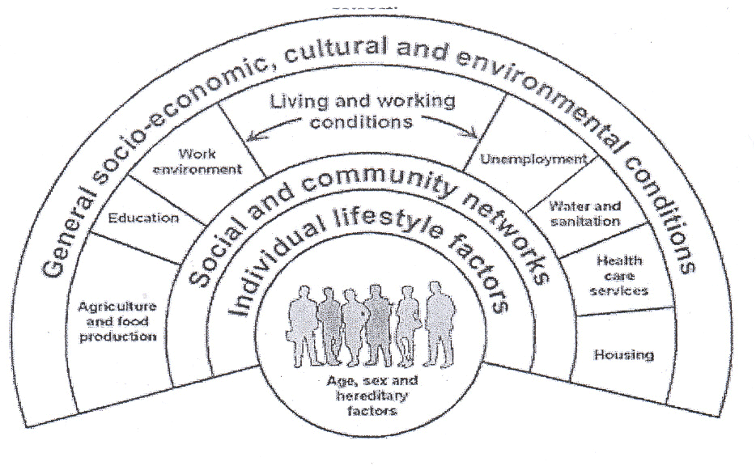
Framework of Social Determinants of Health Inequality (commonly adopted)

Slide 24
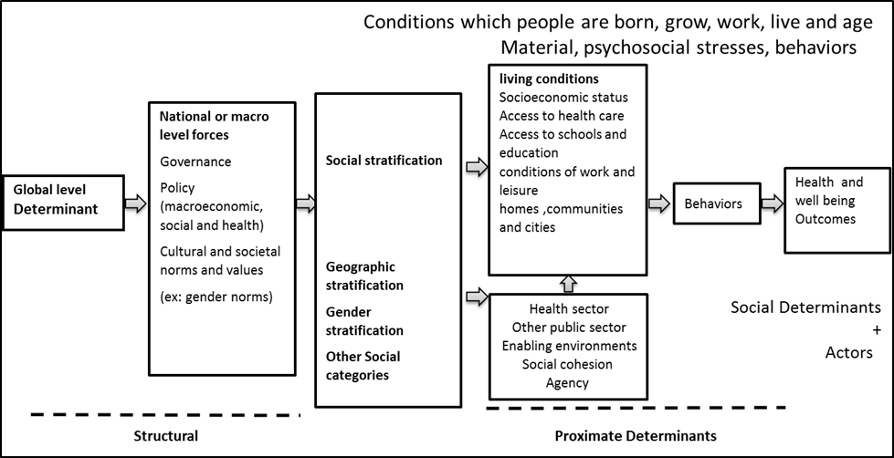
Framework of Health Inequity
Figure 1: Social Determinants of Health Equity Framework

Slide 25
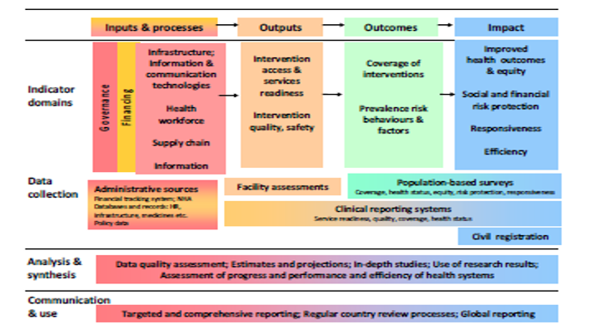
Framework of Health System Inequity
HS is a key SDH: It contributes to health inequalities
+ prevent and ameliorate inequalities
WHO Operational HS Monitoring Framework
Fairness of the dist. of 4 domains SRH Equity

Slide 26
IV. Implications
Research
Policy
Research
Implications of HE on Research:
Framing Research
DATA DO NOT TELL A STORY
RESEARCHERS DO!

Slide 27
VI 1. Implications on Research
Asking right questions
Why: Evidence linking Differential Contexts with Different Health Outcomes
Evidence Linking Current Policies to Differentiated Contexts
More Importantly
What: Evidence Demonstrating the Equity Health Impact of social Actions

Slide 28
VI 1. Implications on Research
WHO (2004) rightly requests research that:
Goes beyond the behavioral and other individual determinants of illness;
Examines the link between proximal and structural (distal determinants of ill health (a link that is often poorly conceptualized and integrated into research); and
Explores the institutions and processes that lead to the social allocation of resources for health

Slide 29
VI 1. Implications on Research
This shift in international thinking asks a simple question: Why systematic inequalities in health are occurring? The question, while posed as a research query, is mainly intended to support policies and actions to address the inequitable distribution of health and to contribute to a movement of policy reforms.
It is important to note that the question on determinants of health inequalities is not new and has been dealt with in a reasonable number of studies. What is new is the driving question is no more that “why the disadvantaged practice risky health behavior?” but is “why the disadvantage itself is occurring?” The focus now is on the distribution of disadvantage in societies, and the fairness of this distribution.
Such a focus in research demonstrates the difference between inequalities and inequities..

Slide 30
VI 2. Implications on Policy
Convergence of Health and Development Fields
SDH Movement Should embrace HE Movement (Fair Social Arrangements, ‡ Medical Monopoly
Development Field Should embrace HE Movement (Social Success, Structural Drivers, Governance)
HE is a Hope Movement not a Blame Movement
It moves Policies from the Paralyzing Acceptance that Nothing Could be Done to Change Health Inequalities or the Assertion that we are doing our Best Within Limited Resources.
To
Movement of Policy Reforms within Existing Resources
(Whole of Gov. Vision/Commit; HEiAP; ISA; HS reforms, M&E of HE)

Slide 31
VI 2. Implications on Policy
Policy Implications
Equity is a social success
Measuring, monitoring, accountability
Push health equity to the forefront of attention and to consider health equity as a social success. Health Equity in All Policies is an expression of the commitment. The systematic monitoring of health inequalities and the tracing of their origin linking them to the performance of political, social and economic forces (causes of the causes) as well as the fairness of these policies (from inequality to inequities) are pre-requisites to demonstrate such country’ commitment.

Slide 32
Def of actors and actions
From Health Policy to Policies for Health
Beyond monopoly of HS
The need for comprehensive policy reform. Such policy reforms should frame health as a corporate priority in public policies and intersectoral actions

Slide 33
VI 2. Implications on Policy
The concern with health equity is the mandate of the whole development field and the social sectors and cannot be delegated to the health sector alone. Indeed The commitment to SDG is an opportunity for both health and development field to work together (HEiAP and ISA) to achieve both health and other sectoral goals (health is an input and output) through adoption of fair transformative social public policies.

Slide 34
VI 2. Implications on Policy
Policies and Actions on the social determinants of health. Inequities must embrace all the key sectors of society not just the health sector. Such policies and actions must involve the whole government, civil society and local communities, business, global for a and international agencies. Intersectoral actions are an important modality of work that requires structural, logistical and financial consideration.

Slide 35
VI 2. Implications on Policy
Health system inequities are part and parcel of social determinants of health but equity in health care is not a proxy for equity in health status. It is necessary but not sufficient.

Slide 36
VI 2. Implications on Policy
The minister of health and the supporting ministry are critical to global change. They can champion social determinants of health approach at the highest level of society, they can demonstrate effectiveness through good practice, and they can support other ministries in creating policies that promote health equity. The WHO as the global body for health must do the same on the world stage.

Slide 37
VI 2. Implications on Policy
This necessitates a new stewardship role of the Ministry of health or even better establishment of a high health council, the stewardship role implies redefinition of role of the body entrusted with health.
This body is:
Not only “Producer of health and health care”
But
“Purveyor of a wider set of social norms and values”
This necessitates:
Monitoring, Analysis, Advocacy

Slide 38
V. The Urgency of Action on HE in the Arab Region: WHY?
(Rationale, Status, Policies)
Rationale : Individual Level
Inequity in itself is a Disease -→ Sufferings, isolation, Frustration, Depression, Aggression
H in E are Priority Public Health Conditions
1. Rationale : Societal Level
Ethical Imperative :(grounded in HR & SJ) Denial of a Fundamental Human Right Due to: “Unfair Economic Arrangements, Bad Social Policies, and poor politics” (CSDH, 2008, P.35)
Future We Want :Public Aspirations for Fairness & Indusiveress
Threat: breaking the fabric of a cohesive society; marginalized, disgruntled and polarized social groups, threatening security of nations
Efficiency: Long term, preventable, sustainable, health promotion policies
HE is an Outcome Measure of Development & Social Success

