Slide 1
Frameworks and actions on Maternal Mortality
Consultation Meeting on “ Mainstreaming a Social Determinants of Health Equity Framing in Actions to Address Maternal Mortality”
23-24 July 2023
Amman, Jordan
Prof. Hoda Rashad
Citation:
Rashad, H. (2023, July 23-24). Frameworks and actions on Maternal Mortality [PowerPoint presentation]. Consultation Meeting on “Mainstreaming a Social Determinants of Health Equity”, Amman, Jordan.

Slide 2
Objectives
Discuss and Agree on Priority Social Determinants, Identified in the Literature, Influencing Level and Trends of Maternal Mortality.
Discuss and Agree on Priority Social Determinants, Identified in the Literature, Shaping Maternal Mortality Inequities.
Discuss and Agree on Priority Social Determinants That Are Particularly Relevant to Jordan.

Slide 3
Why Review Frameworks?
The framework guides the identification of:
Key set of priority social determinants and their pathways of influence.
Evidence based diagnosis of challenges in social determinants influencing MM and MME, as well as missing evidence to support such a diagnosis.
Evidence based recommendations of actions and policies.

Slide 4
Three Groups of Frameworks
Health System Related Determinants Frameworks
Social Determinants of Health Frameworks
Social Determinants of Health Equity Frameworks

Slide 5
Figure 1: Health System related determinant framework
Pre-conception Phase
Pregnancy Phase
Delivery Phase
Reproductive health condition
Diseases & Health Conditions
Respiratory diseases
Cardiovascular diseases
GIT diseases
Kidney diseases
Endocrine diseases
Neurologic disorders
Anemia
Metabolic disorders
Immunologic disorders
Cancers
STIs/AIDS
Others
Delay 1
Awareness
Perception
Delay 2
Distance
Transportation
Affordability
Antenatal Practices
Livelihood
Nutrition
Harmful practices
1
Non-obstetric
Maternal Mortality
Maternal Mortality Inequities
Antenatal Services
Utilization
AAAQ
Obstetric
Delay 3 (delivery services)
Skilled personnel
Quality
Emergency & referral
2
1
Pre-conception Services
Utilization
AAAQ
Contributing causes
(Indirect causes)

Slide 6
- 4 sub frameworks, “3AQ” criteria
Delivery phase dominant
Sudden
HS driven
Antenatal Care MM (not strong)

Slide 7
Pathways in HS Framework
WHO Cause of death classification of maternal mortality allows a differentiation between obstetric causes and non-obstetric, as well as contributing causes.
Def of Obstetric (Direct) Causes: “those resulting from obstetric complications of the pregnancy state (pregnancy, labor and the puerperium), from interventions, from omissions, incorrect treatment, or from chain of events resulting from any of the above”.
Def of non-obstetric (indirect) causes: “Those resulting from previous existing disease or disease that developed during pregnancy, and which was not due to direct obstetric causes, but which was aggravated by the physiological effects of pregnancy”.

Slide 8
HS Framework
Def of Contributing Causes: “conditions that may have contributed to or may be associated with mm but should not be reported as sole condition on the death certificate or selected as an underlying cause of death, they may predispose women to death, either as a preexisting condition or risk factor.”
Preexisting conditions predisposing women to maternal death or maternal morbidity include: Reproductive ill-health, anemia, diseases (cardiovascular, respiratory,…), high parity, old ages.

Slide 9
- Contributing causes of MM are known to shape non- obstetric causes and to interact with obstetric causes in influencing MM. These pre-existing conditions contribute to MM attributed to DELAY 3, but the difficulty of disentangling their role in shaping MM reinforces the significance of obstetric services in relation to delay 3 and the neglect of social forces.

Slide 10
- The contributing causes are mainly governed by risks during pregnancy and pre-conception phases. The social determinants of these risks influence MM. The larger the contributions of preexisting conditions to MM the more important the social determinants and social interventions in addressing MM.

Slide 11
- WHO classification is drawn upon to identify the type of causes (obstetric or non-obstetric), lending themselves to medical interventions, that need to be addressed. The recommended priority interventions are skilled attendance at birth and emergency referrals. This is justified by the weight of obstetric causes and the unexpected sudden occurrence of obstetric complications in causing MM.

Slide 12
Pathways in HS Framework
- The three delays model (figure 1.a) is widely utilized to describe the determinants of timely utilization of quality delivery care. Social determinants in this model are “socially mediated” medical determinants. They mainly govern decision to utilize delivery care facility (delay I) and access to such utilization (delay II). Delay III is mainly explained by quality of delivery services.

Slide 13
FIGURE (1.a): Health System Related Framework for Phase III: Three Delays Model.
Factors Affecting
Utilization and Outcome
Phases of Delay
Socioeconomic/
Cultural
Factors
Phase I:
Deciding to Seek
Care
Accessibility
Of
Facilities
Phase II:
Identifying and
Reaching Medical
Facility
Quality of Care
Phase III:
Receiving Adequate
and Appropriate
Treatment

Slide 14
- The health care related frameworks do not allow adequate attention to the separate pathways of influence of social determinants on MM. They relegate social determinants as those influencing the utilization, access and quality of medical interventions. They encourage the adoption of “ socially sensitive” medical actions.

Slide 15
- The difficulty of assessing the role of contributing causes, antenatal practices and pre-conception risks in influencing MM supports the neglect of underlying social determinants in shaping MM.

Slide 16
- The social determinants introduced in this framework are minimum set. They capture the importance of situating health system utilization and performance within the social context that impede or support such performance. The social context is usually defined by individual .and community level characteristics. These are used to guide socially sensitive medical and health system interventions.

Slide 17
- Key social determinants in health system related frameworks are those operating at individual levels such as awareness, command of financial resources, women autonomy in decision making for health service utilization, as well as community level support that includes transportation services, roads, financial systems of support, …etc.

Slide 18
- Evidence based analysis, using both quantitative and qualitative approaches, is used to identify contextualized challenges and actions.

Slide 19
SD MM Frameworks
Trajectory of Development, Human Rights, HS approaches
Obstetric transition phenomena
Life Cycle & Multilevel Frameworks

Slide 20
Life Cycle Framework
Why Did Mrs X Die
“ High maternal mortality rate are an indication not only of poor functioning health system, but also of deep seated gender inequalities that leave women with limited control over decision making and that restrict their access to social support, economic opportunities and health care. These gender inequalities manifest early in life; girls born into poverty are more vulnerable to child marriage and exploitation, such as sex trafficking or forced labor. Adolescent girls frequently lack the power to decide whether contraceptive is used during sex, or whether sex takes place at all. This places them at high risk for early pregnancy and its resulting complications”.

Slide 21
Multilevel Framework
“ The characteristics of individual women like age, number of previous pregnancies, and education level play a role in determining whether they seek appropriate services, but the underlying factors influencing health behavior operate at inter-related levels of social influence: family and peers, the community in which women live and the health system available to them, wider cultural norms, the legal and policy environment and overarching government structures (UNDP, 2001. p.2).

Slide 22
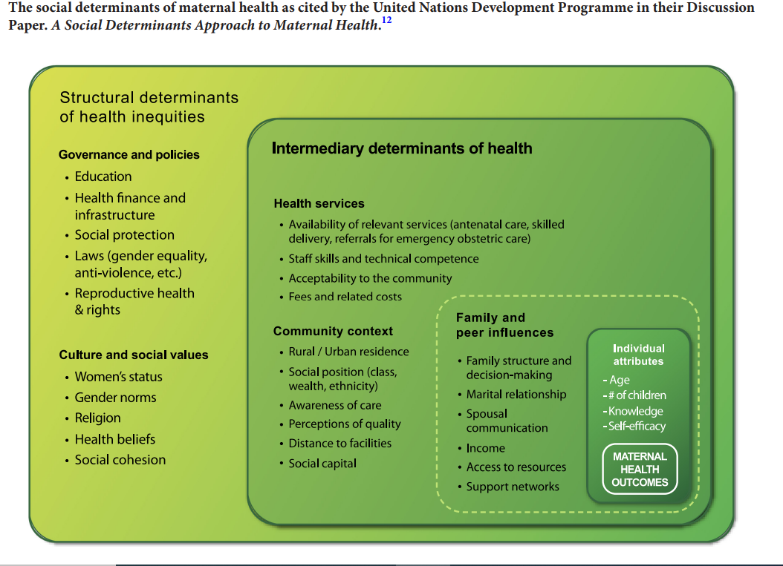
Figure 2: Conceptual framework - SDH of Maternal Health

Slide 23
Pathways of Influence
Utilization of HS
The same framework could be used to emphasize the pathway (behavioral and environmental risk factors) resulting in poor reproductive health, anemia, and other diseases. Figure (2,a) provides such a framework.

Slide 24
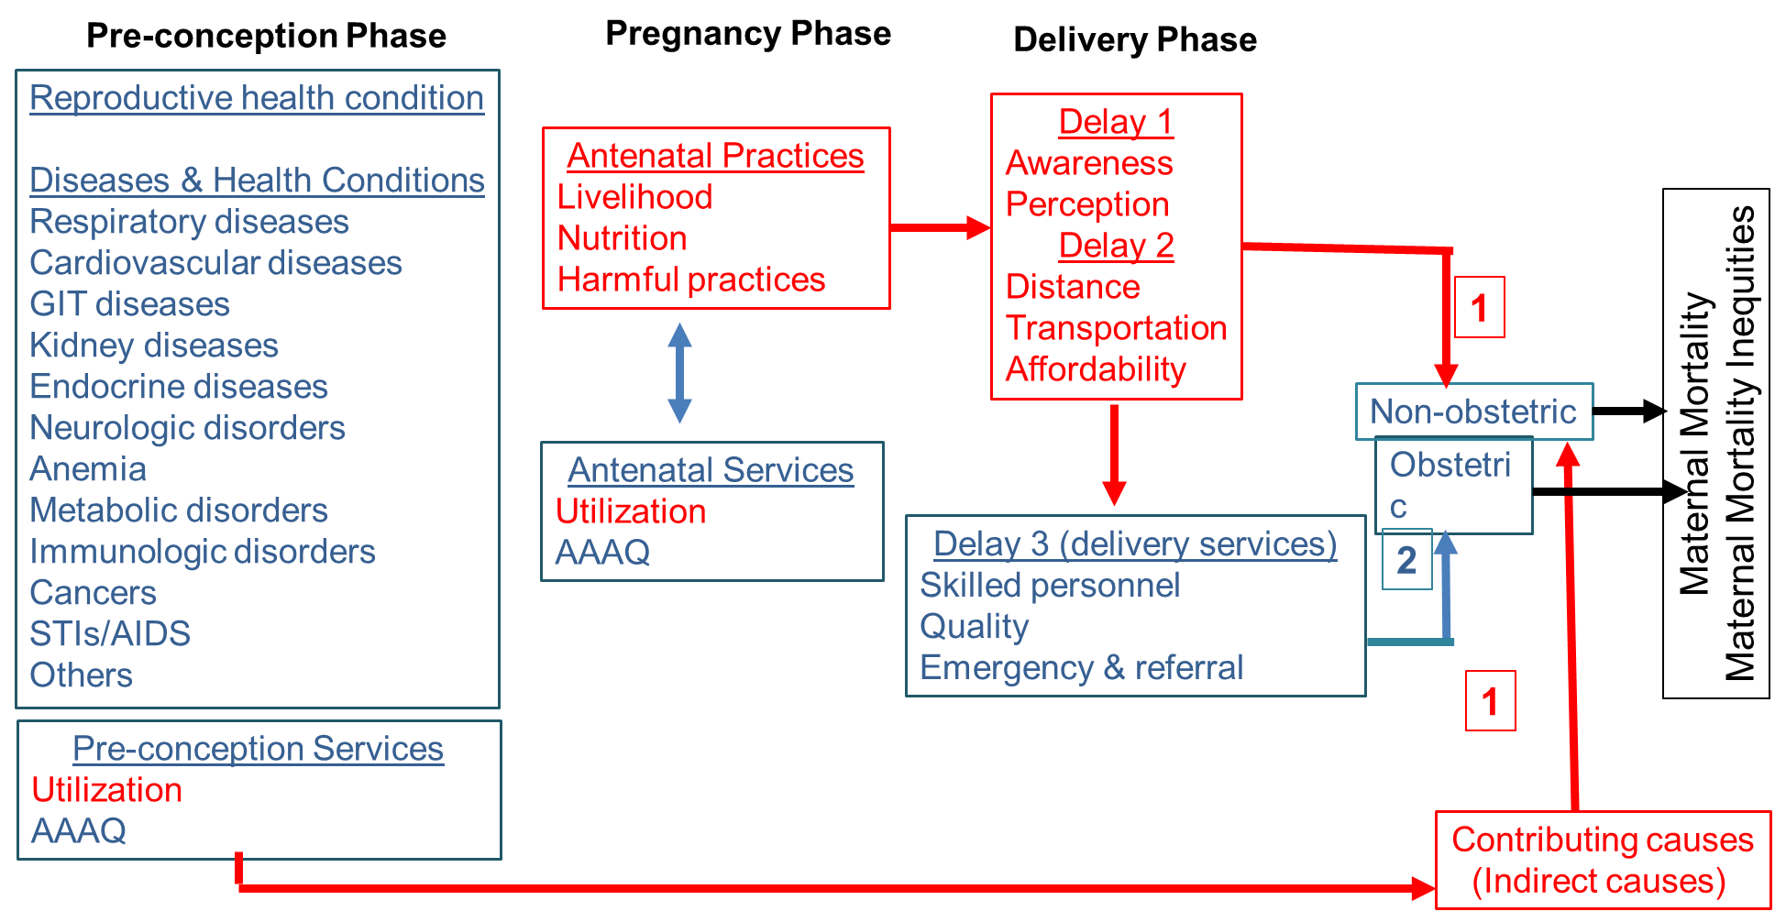
Figure 2A: SDH Framework
Risk factors
Life course
“Why did Mrs. X die”
Community & Individual Determinants
Reproductive Risks
FGM/C
Consanguinity
Early age at marriage
Adolescent childbearing
High parity
FP Risks
Awareness & acceptance
Unmet need
Unintended pregnancy
Gender health risks
Gender-based violence
Gender norms
Other health risks
Nutrition
Harmful behavior
Biological
Community Attributes
Individual Attributes
Governance (Fairness, social justice, accountability, transparency)
Partnership
Policies
Rule of laws
Cultural, traditions and social forces
Preparedness to respond to emergencies and shocks

Slide 25
Diagnosis of Social Challenges in SDH Frameworks:
Reproductive patterns, reproductive health, and health conditions are key determinants of MM. Preventing unintended pregnancies, promoting reproductive health and health in general are key interventions.
Examples of social sectoral actions is support realization of “3AQ” criteria for health care, Improving education and economic support to women.
Example of HS multisectoral actions is liaising with community actors to address transportation constraints affecting utilization of health services.
Example of social multisectoral actions is including family planning awareness in educational promotion.
Intersectoral approaches call for both social sectors and health sectors to develop jointly a strategy and actions to reach a common goal. These could target pre-conception risk factors such as early age at marriage, or violence against women.

Slide 26
- The relative contribution of social versus health system related determinants of MM is extremely difficult to disentangle with the levels of evidence available. however, what is clear is that “the risk factors associated with maternal outcomes ……. are typically outside of woman’s control and are often indicators of social inequality and disadvantage”.

Slide 27
- Actions on social fronts would not only reduce MM but also reduce severe maternal morbidities and adverse pregnancy outcomes. These include: near misses, post-delivery morbidity, fetus loss, birth defects,…).

Slide 28
The social framing of health emphasized social forces operating at individual and community levels (proximate levels) producing risky health behaviors and exposures.
The human right movement provided the Moral Rationale for the duty of the state and communities to promote health and prevent the extra health sufferings whenever feasible.

Slide 29
- The focus on proximate SDH and the Moral Obligation couched the whole discourse in a social development discourse constrained by the available economic resources and ineffective health system policies.

Slide 30
Policies and Actions included the combination of:
Socioeconomic policies (development in general),
Gender and women empowerment policies,
Targeting Disadvantaged (community level initiatives, targeted social support, socially sensitive medical interventions (multi-sectoral)),
Increasing financing of health system and its efficiency.

Slide 31
- The interventions in this frame did call for upstream policies and actions. These particularly include: development, gender and legal reforms. These comprise a trajectory of health system, development and human right policies and actions.

Slide 32
- The approaches adopted are sectoral, multi sectoral and intersectors.
Multisectoral is defined as:” as action led by the health sector with support from other sectors”
Intersectoral is defined by the World Health Organization as “a recognized relationship—ranging from a formal agreement to an ad hoc group—between different sectors of society working together in a way that can improve outcomes more effectively, efficiently, or sustainably than when working independently from one another, the objective is to achieve a win-win situation for all parties”

Slide 33
Examples of sectoral actions is realizing “3AQ” criteria for health care, Improving education and economic support to women. Example of HS multisectoral actions is liaising with community actors to address transportation constraints affecting utilization of health services.
Example of social multisectoral actions is including family planning awareness in educational promotion.
Intersectoral approaches call for both social sectors and health sectors to develop jointly a strategy and actions to reach a common goal. These could target pre-conception risk factors such as early age at marriage, or violence against women.

Slide 34
Social Determinants of MME Frameworks
MME framework applies a social framing of health (SDHE) on MM.
The SDHE emphasizes the fairness of social forces operating at upstream levels (governance and policies, and intervening forces) and linked the fairness in upstream determinants to unfair social stratification in society producing the inequitable distribution of health challenges.

Slide 35
The focus on fairness and upstream forces provided an ethical imperative and urgency rationales for the duty of the state and social sectors to pursue a fair socio-economics development and to be accountable for promoting health and reducing health inequities.

Slide 36
SDHE is anchored on social justice framing and transformative changes. HE in the recent discourse is not confined to addressing deprivation, targeting individual and community levels’ deprivation.
HE, defined as absence of systematic unnecessary differences in health, is not just a health goal but a development goal and a measure of social success. This captures the understanding that HE is achieved through fair health systems and fair social determinants.

Slide 37
Key Features
From Inequality to Inequity.
From Moral Duty of State to Ethical Imperative and Risks of Not Acting.
From Proximate (characteristics, behavior) to Social Stratification.
From Influence of Social Sectors to Responsibilities and Accountability of Social Sectors.
From multi-sectoral to intersectoral.

Slide 38
Implications for Health System
Reduction of inequalities in health is a central goal. Index of dissimilarity provides a summary measure of differences in burden born by different groups.
Health System Inequities are part and parcel of social Determinants in Health
Capitalizing on the strength of PHC and revival of interest (responding to needs, concern with social context, multi-sectoral, community empowerment and participation, amenable to MoH)
Pushing boundaries for:
Defining what constitute public health programs → social policies (involvement of HS/multi-sectoral, inter-sectoral)
5. Evidence based monitoring and evaluation: From Health Information System (HIS) to Information System for Health ( HIS).

Slide 39
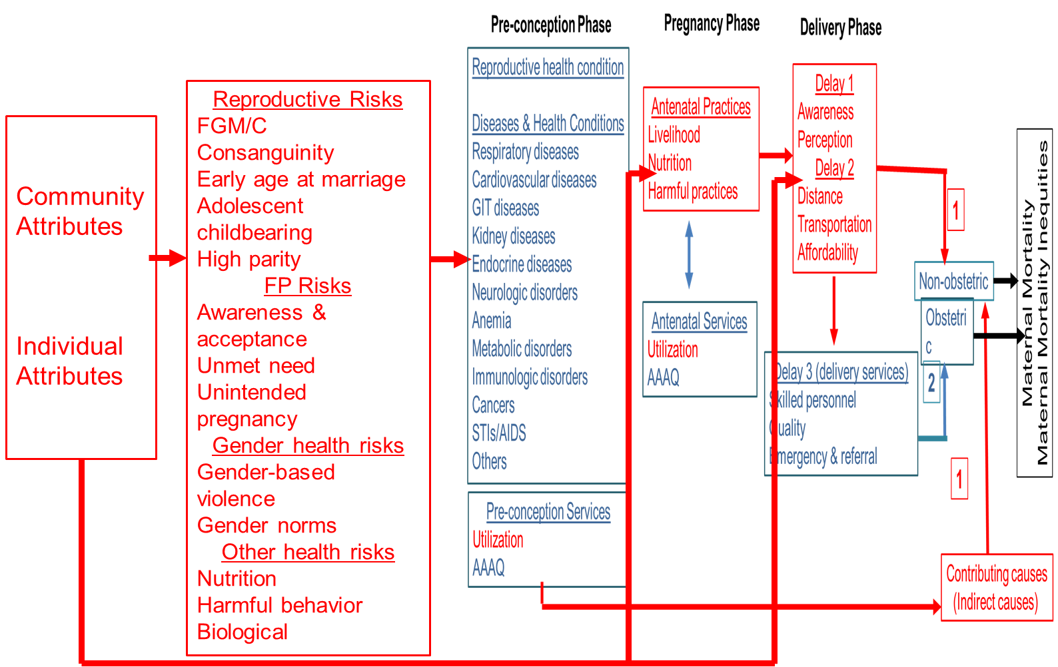
Figure 3: SDMME Framework
Fairness
Governance (Fairness, social justice, accountability, transparency)
Partnership
Policies
Rule of laws
Cultural, traditions and social forces
Preparedness to respond to emergencies and shocks
Social position
Gender norms
Geographic location
Equity Lens
Intervening Forces
Levels, disaggregation and distribution by social structures and efforts modalities (multisectoral, intersectoral or trans-sectoral)
Health care system
Other systems
Other stakeholders

