Slide 1

Towards formulating a policy framework for harnessing the second demographic Dividend in the Arab countries
Ageing in the Arab countries:
Realizing the Potentials of the Second Demographic Dividend
21st November 2021
Zeinab Khadr
The Social Research Center
The American University in Cairo

Slide 2
Introduction
Demographic dividend: explained
Decline in fertility levels lead to substantial changes in the age structure of the population. These changes contribute to
First Demographic divdend:
  Working age population share increases
  Young and old dependents share decreases
  Taking advantage of the abundant labor supply (Supportive economic context) contribute to substantial economic growth
Second Demographic dividend
  Increases in adult longevity
  Working age population’ savings are higher than that for young and old population as their earnings usually surpass their consumption.
  Rationale behavior within the life cycle dictates increasing the savings during working age to provide for themselves during retirement age.
  With the large sharing of working age, those saving creates a capital accumulation which can be base for high economic growth for the future generations

Slide 3
Introduction
Fertility declines in the Arab countries have generated significant changes in their age structure
In 2020, only 7% of the population in the Arab countries are aged 60 years and older
By 2050, this proportion will be more than doubled reaching 15% of the total population with more than 101 million people aged 60 years and older.

Slide 4
However, this overall statement hides significant differences in proportion of older persons and overlap between 1st and 2nd dividend
and working age persons
Proportion of older persons 60+

Slide 5
These changes in the age structure call for balancing the needs of the different age groups
Group A:Mainly Gulf countries
  experiences a post-1st dividend
  A decline in working age population and rapid increase in older persons
  (How are they going to deal with declines in working age)
Group B: Lebanon, Tunisia, Morocco, Algeria and libya
  passing towards the end of the 1st dividend
  A decline in working age population and rapid increase in older persons
  (How arethey going to deal with declines in working age)
Group C:All other countries
  experiences an overlap between the 1st and 2nd dividend
  Continue growth of working age and rapid growth of older persons
  (How are they going to cope with the needs of their children, working ages and older persons at the same time)

Slide 6
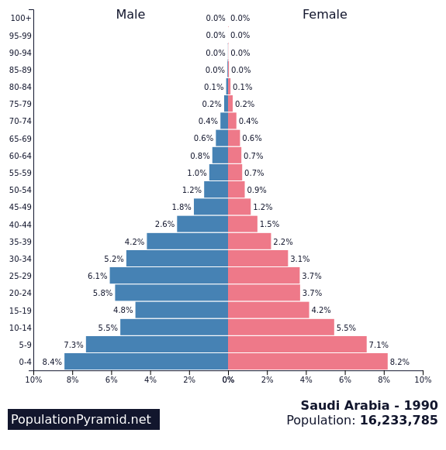
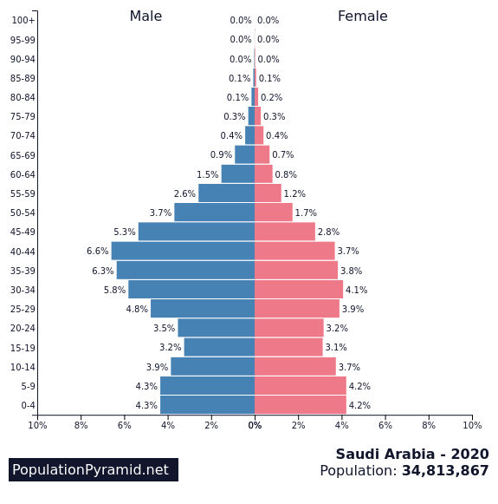
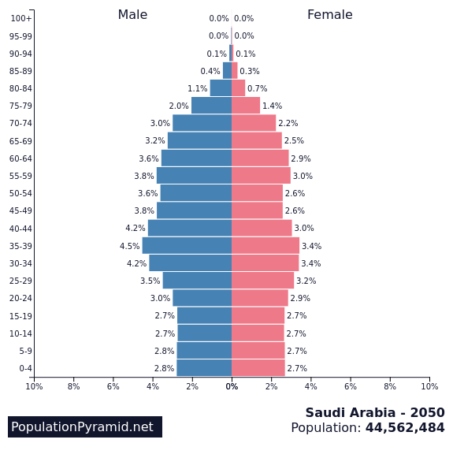
Demographic dividends: Saudi Arabia
1990
2020
2050
Large increases in older persons and declines in working age

Slide 7
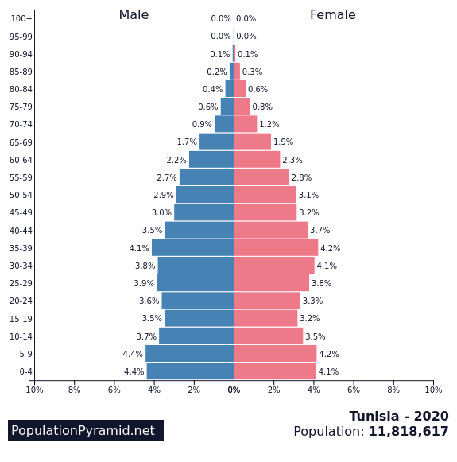
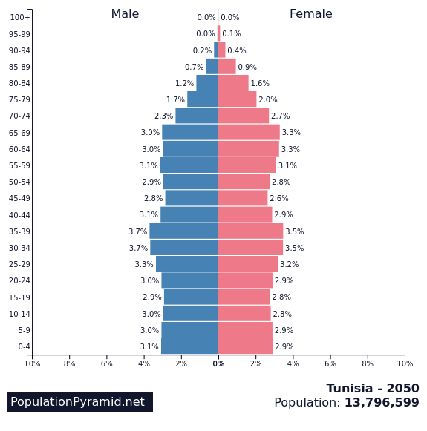
Demographic dividends:
Tunisia
1990
2020
2050
Large increases in older persons and declines in working age

Slide 8
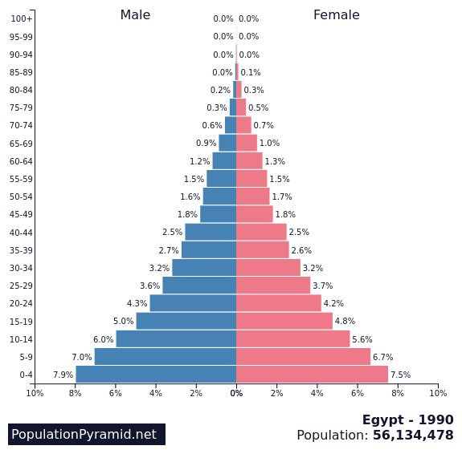
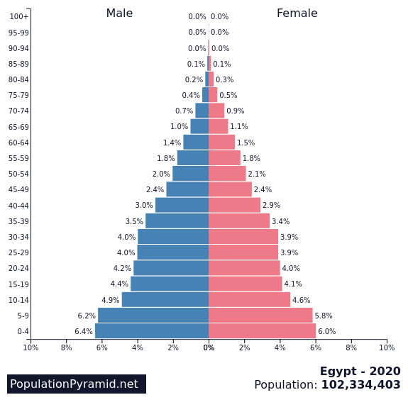
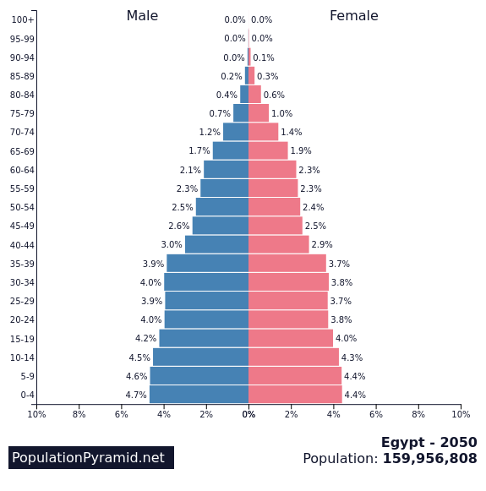
Demographic dividens: Egypt
1990
2020
2050
Large increases in older persons and continued increases in working age

Slide 9
Are the Arab countries prepared to cater for the these rapidly changing age structures and our greying generations
This question has been posed by all developing countries.
The final conclusion is that there are a myriad of policies to achieve the full potential of the next greying generations with older persons well being lying at its heart and adopting both a right based approach and a life course prespective
Start with young people now , not later when they aged
These policies are interlinked and require significant coordination among the different partners

Slide 10
Schools of thoughts for harnessing the second demographic dividend
 | Social | Macroeconomic
Underlying issue | Large aging cohort | Large segment of the population not economically active
Approach adopted | Wellbeing, protective, caring and right based approach | Wellbeing, empowerment , investment and output oriented
Basic interventions | Care oriented, human right approach | Engaging and inclusive
Ultimate Goal | Older persons wellbeing | Older persons wellbeing and securing economic growth for the whole society

Slide 11
Macroeconomic recognizes that older persons welling can be defined in terms of five main dimensions
Security
Human security means safety from such chronic threats as hunger, disease and repression and protection from sudden and hurtful disruptions in the patterns of daily life
Equity
Social engagement:
The extent to which an individual participates in a broad range of social roles and relationships.
Security
Engagement
Older persons’ well being
Dignity
The right of a person to be valued and respected for their own sake, and to be treated ethically
Dignity
Productive
Leisure
Productivity
Producing or able to produce large amounts of goods, crops, or other commodities.
Leisure
Engagement in joyful activities during the individuals’ free time

Slide 12
Macroeconomic perspective
In other words, this perspective approaches longevity not a mere adding years but a high quality life while sustaining efficient and full engagement in the society with the aim of leading happy and productive life.
It calls for
  life long education,
  Recast work-life trajectories,
  Adaptive environments,
  Healthy lifestyles, and
  Equitable healthcare systems in ways that lead to more happy and productive years.
Ultimately, seeing longer lives not as a burden, but as a benefit.

Slide 13
Policy domains for harnessing the second Demographic Dividend
Innovation &
technology
Supportive physical environment

Slide 14
Intergenerational relationship
Tackling old age loneliness and social isolation
Improve physical and mental health
Voice and agency
This is usually done through engaging older persons in community development activities
Volunteering
Active participation in the labor market
This is strongly interlinked with other policy domains
Life long education
Work environment at various dimensions
Physical environment(age friendly cities)
Technology and innovation

Slide 15
Life long education
Life long education is intended to well prepared young people as well as older persons
full engagement in the society
capacities for labor market
capacities for managing their financials
Voice and agency
Rising aspiration
Senior University in AUB

Slide 16
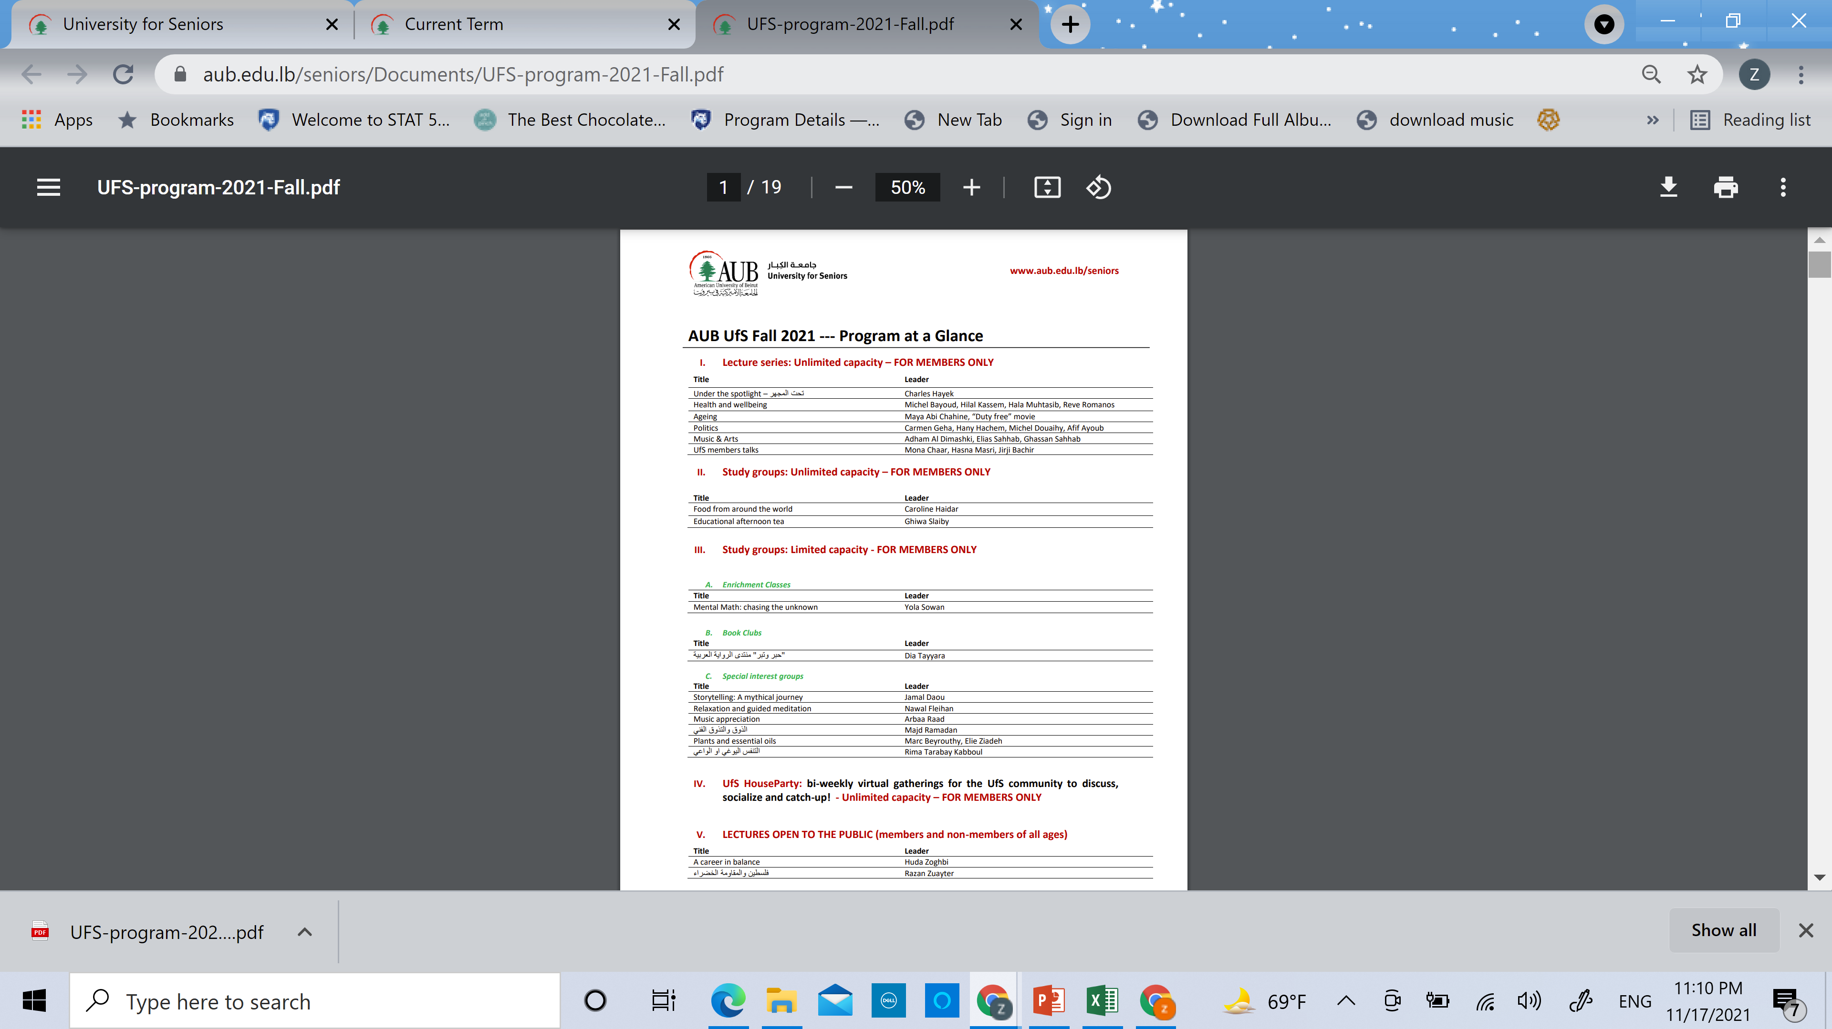

Slide 17
Health & health care
Health move beyond the mere physical conditions to adopting health lifestyle and more new aspects in health
Vaccines and immunizations
  Nutrition
  Physical activity
  Risky behaviors
  Screening
  Food safety
  Drug safety
  Medical device safety
  Environmental health
E-health
Telehealth

Slide 18
What is the impact of technology on older persons’ health
Improve caregiver effectiveness
Increase accessibility
Facilitate healthy aging at home
Improve early detection and early intervention
Ensure ethics and responsibility
Use of Artificial intelligence to predict illness
Create simple interface
Scale solutions

Slide 19
Financial security
Financial security is at the heart of the 2nd demographic dividend
Policies calls for
  Supporting policies for an accommodating and supportive engagement of older persons in labor market
  Reform pension policy to encourage labor force participation across the age distribution
  Resturcturing tax policies for it distributional impact for pension savings
  Expansion of the social and medical security safety net

Slide 20
The SDG 1.3.1 measures:
The proportion of the population covered by social protection floors/systems, by sex, got older persons
Sources: ILO, World Social Protection Database, based on SSI; ISSA/SSA, Social Security Programs Throughout the World; ILOSTAT, ECLAC, IMF, WHO, WB, UNDP, UNICEF, completed with national data sources.

Slide 21
Work and productivity
Questioning the retirement age
  Retirement age was set 60 and 65 years, when life expectancy at birth was less than 70 years
Supportive environment
  Accommodating physical context (age friendly cities/ Assistive technology)
  Accommodating and fair work conditions
  Education to enhance social and economic engagement and access to services and knowledge

Slide 22
Innovation and Technology
Assistive technology (Source :WHO)
Assistive technology is an umbrella term for assistive products and related systems and services.
Assistive products are used by persons with permanent or temporary functional difficulties to enable and enhance their participation and inclusion in all domains of life.
They can support cognition, communication, hearing, mobility, self-care and vision.
Assistive products may be “physical” products such as wheelchairs, eyeglasses, hearing aids, prostheses, walking devices or continence pads; or they may be “digital” and come in the form of software and apps that support communication, time management, etc.
They may also be adaptations to the physical environment, for example portable ramps or grab-rails.

Slide 23
Physical Environment
Age friendly cities
(WHO)
The WHO Age-friendly Cities framework proposes eight interconnected domains that can help to identify and address barriers to the well-being and participation of older people.
  Outdoor spaces and buildings
  Transportation
  Housing
  Social participation
  Respect and social inclusion
  Civic participation and employment
  Communication and information
  Community and health services

Slide 24
Policy implications
& way forward
Public policies must achieve the balance between caring for children, seniors and enhancing working age adult capacities
Acknowledge and support women’s full contribution to national economics
Promote volunteering culture
Support active learning, vocational training, financial capacities for older persons
Pension reform in particular in high levels of informality in the labor market
Support domestic investment with the aim of increase labor market participation, labor productivity
Direct significant attention to the distributional impact of tax policies
Reforming labor policies to secure accommodating and right based work environment for older persons
Promote the use of innovation and technology across all life dimensions
Support efforts toward restricting our cities to be age friendly

Slide 25
Needs for policy development
Adopt the specific policies proposed by the macroeconomic perspective and infuse it with the human right approach and an equity lens
DATA and INFORMATION BASE
  Comprehensive data by age, gender and social position and adopting a life course perspective
  EMage initiative
Recognize the importance of Intersectoral Action in addressing the potentials of the second demographic dividend

Slide 26
Thank you
Visit our Healthy aging webpage on HE_SDG _Arab region
https://www.aucegypt.edu/research/src/sdg-health-equity-arab-region/healthy-ageing

