Slide 1
Strategy Management & Digital Innovation Business Plan 2019-2022

Slide 2
01
01
Mission, Organization & Themes
Agenda
A brief glimpse on our mission, structure & functions.
02
Challenges & Accomplishments
A brief overview of our challenges & accomplishments.
03
Objectives, KPIs & Targets
A overview of our goals & their links with the AUC Strategic Pillars

Slide 3
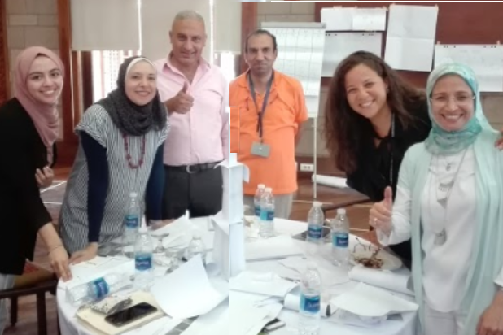
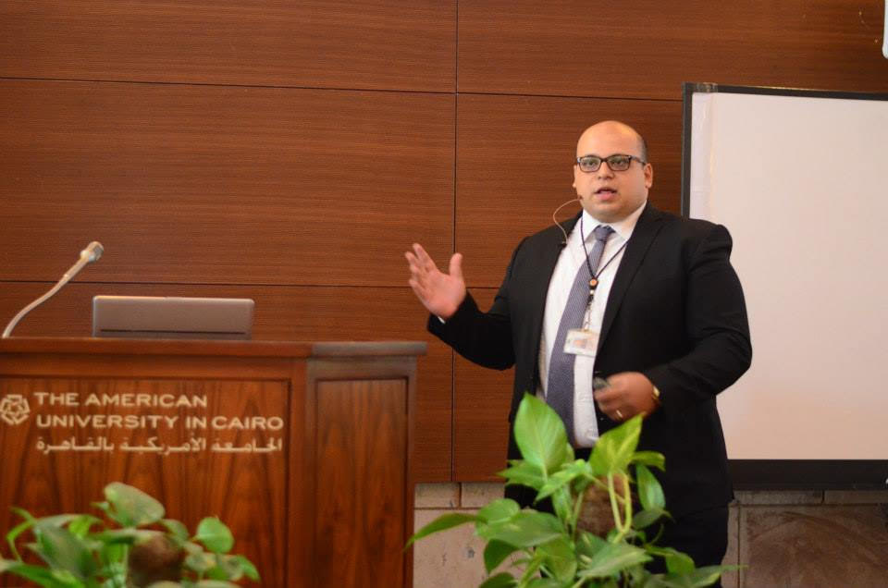
Mission Highlights
Strategy Management & Institutional Effectiveness
Information Technology
Information Security
Institutional Effectiveness
Strategy, Assessment & Business Processes
Knowledge Management
Institutional Research
Business Intelligence & Analytics
Surveys & Benchmarks
Optimum protection for AUC Information and Technology assets
Proactive, risk based, business- oriented Information Security
Well-defined governance
People, Services & Technology
Reliable, Up-to-date & Responsive
For Teaching & Research
The American University in Cairo | Strategy Management & Digital Innovation
Notes:
The Strategy Management and Digital Innovation area covers many vital functions that are fundamental to the effectiveness and running of AUC. First the Strategy Management and Institutional effectiveness Office, whose mission is …... (brief – don’t read all on the slide); IT whose mission is ...... ; and IS whose mission is ........

Slide 4
Meet Our Team
Strategy Management & Knowledge Officer
Institutional Research, Sr. Director
Strategy Management, Sr. Director
Assessment & Accreditation, Sr. Director
Chief Technology Officer
Chief Info. Security and Risk Officer
Business Process Improvement, Director
Business Intelligence, Sr. Director
Strategy Management
Integrated Planning
(Resource Alignment)
Institutional assessment & accreditation
Surveys & assessment tools
Business Process Documentation & Improvement
Business Process Repository Management
Data Governance & Quality Assurance
Ranking
Official publications & reports
Business Intelligence
Advanced Analytics
Data Mining & Data Science
Infrastructure
ERP
Classroom Technology
IT Services & Support
InfoSec Policies, Governance & Controls
Info Risk Assessment
Business Continuity
Strategy & Institutional
Effectiveness
Knowledge Management
Digital Innovation
4
The American University in Cairo | Strategy Management & Digital Innovation
Notes:
Looking more closely at the area, you can see we have three main fuctions: Strategy and Institutional Effectiveness: with three main sub functions: Strategy Management led by Alia Mitkees who is responsible for…...; Assessment and Accreditation led by Heba Fathelbab who is responsible for ....; etc.

Slide 5
Strategy Management & Institutional Effectiveness
Knowledge Building, Management & Governance
Information Technology
Information Security
KEY THEMES & GOALS
Goal 3: Build & Nurture a Knowledge-Empowered Institution through Business Intelligence, Advanced Analytics, Surveys, and Benchmarking using best practices in Data Governance and Management
Goal 4: Building Strong IT Roots in terms of Human Capital, Governance, Infrastructure, Systems (ERP) and Robust Integrations
Goal 5: Supporting a Student-Centered Institution through Advanced Technology to enhance the AUC Experience by Going Paperless and reaching out Beyond the Campus
Goal 6: Deliver a complete real picture for AUC Information Security and Information Risk posture using common business language in order to support management’s decisions
Goal 7: Manage Information Security governance decisions in an alignment with international standards, regulatory constraints and management’s risk appetite
Goal 1: Contribute to Emphasizing AUC’s Reputation & Status as a World-class University Recognized for its Leadership & Excellence
Goal 2: Lead & Direct the University’s planning processes & the continuous assessment of our academic programs and administrative units to enhance Institutional Effectiveness, and improve efficiency through the optimization of business processes
The American University in Cairo | Strategy Management & Digital Innovation

Slide 6
Key Challenges & Accomplishments
CHALLENGES
ACCOMPLISHMENTS
PLAN
Global reputation
Strategy & Institutional effectiveness
Data for decision making
MSCHE accredited & QS Ranking up 25 places
NAQAAE Accreditation
Academic, Employer reputation & Research
AUC’s centennial strategic plan linked to resources (Conference)
Execution & tracking
Closing the loop
Business process repository
Institutionalized assessment
Business process improvement
BI & analytics
Data governance policy & dictionaries
Data sources & analytics
Awareness & enforcement
The American University in Cairo | Strategy Management & Digital Innovation

Slide 7
Key Challenges & Accomplishments
CHALLENGES
ACCOMPLISHMENTS
PLAN
Strategy & structure
Roadmaps, Assessment, InfoSec & Development
Recruitment & Retention of critical skills
Infrastructure
Information Security
(Risk exposure rating: D 66)
Identity Management, Disaster Recovery, Wireless,
Security Awareness
Cloud, Asset Inventory, Firewalls, Patching, OS, & Password Change
(Risk C 76 and B 80)
ERP outdated & integration
Banner on cloud, App, SAP SF, IT ticketing
Upgrades, Cloud, & Integration
The American University in Cairo | Strategy Management & Digital Innovation

Slide 8
Key Goals, KPIs, Targets & Links
A detailed preview of the area’s strategic goals, objectives, KPIs, targets, resources & links to institutional pillars
Notes:
Image source:-
https://pixabay.com/en/computer-keyboard-apple-laptop-2563737/

Slide 9
Key Goals, KPIs, Targets, & Links to Institutional Pillars
GOAL & OBJECTIVE TIME KPI & TARGETS RESOURCES
GOAL 1: Contribute to Emphasizing AUC’s Reputation and Status as a World-class University Internationally Recognized for its Leadership and Excellence
International (MSCHE) and national (NAQAAE) accreditations | NAQAAE Visit: 2019-2020 MSCHE Report | Successful NAQAAE reaffirmation of accreditation | Accreditation costs
Institutional Rankings | AY 2019-2020 | Improve QS Academic & Employer Reputation
GOAL 2: Lead the University’s planning processes and the continuous assessment of our programs & administrative units to enhance Institutional Effectiveness, and efficiency through the optimization of business processes
Institutional Assessment (Assessment of Student Learning) | AY2019-2022 | 95% of academic assessment plans & 80% of reports submitted ; 70% reviewed annually
GOAL 5: Supporting a Student-Centered Institution through Advanced Technology to enhance the AUC Experience by Going Paperless and reaching out Beyond the Campus
Admissions and Financial Aid Application | AY 2019-2020 | 90% increase in process automation
Bring your own Device | AY 2019-2021 | 30% increase in student satisfaction 80% completion of project within time/budget | H/W & S/W resources
Revisiting & Upgrading the Learning Management Strategy & System | AY 2021-2022 | Increase student & faculty satisfaction by 10% | Cloud Hosting Faculty Adoption Campaign (CLT)
Internationalization
Effectiveness
Quality of Education
AUC Experience
The American University in Cairo | Strategy Management & Digital Innovation
Notes:
Our strategic plan links closely to the University Strategic pillars, with clear goals, objectives, KPIs & Targets and Resources as shown.
Quality of education is at the core of our strategic plan, it is clearly linked to our first goal, as obtaining international accreditation and high institutional rankings are only awarded to universities that have achievement a specific quality of education within their institutions. In order to maintain that quality, assessment of our student learning and perceptions of learning are also essential to understand any shortcoming we have to continue to improve our academic educational experience for our students. Furthermore, having the technical support and tools needed by our faculty and students to ensure they are able to implement the level of teaching and learning needed to maintain this quality is where goal 5 comes in.

Slide 10
Key Goals, KPIs, Targets, & Links to Institutional Pillars
GOAL & OBJECTIVE TIME KPI & TARGETS RESOURCES
GOAL 3: Build and Support a Knowledge-Empowered Institution
Measuring stakeholder perceptions through surveys | Ongoing | Annual Institutional Surveys Calendar All key constituents surveyed per year Institutional Survey Newsletter published annually | New Survey tool
GOAL 5: Supporting a Student-Centered Institution through Advanced Technology to enhance the AUC Experience by Going Paperless and reaching out Beyond the Campus
AUC Mobile App New Features | Ongoing | 25% Users Annual Increase 85% Stakeholders satisfaction 2-3 New Features Annually | Professional development
AUC Coin | Ongoing | 25% Users Annual Increase 85% Stakeholders satisfaction 30% Increase in transaction | ATM Integration Open Wallet
Availing Software to AUC Community | AY 2019-2020 | 30% increase in student satisfaction 90% project completion | S/W & H/W resources
Beyond the campus (streaming equipment, Unified access control & move to SMS-cloud based infrastructure) | AY 2019-2022 | 100% installation of new shooting, recording and streaming systems in Alfy, meeting rooms & CVC halls 100% replacement of IP Phones with mobility & collaborative features 100% successful migration to Vodafone SMS cloud based | S/W & H/W, and hosting resources
AUC Experience
The American University in Cairo | Strategy Management & Digital Innovation

Slide 11
Key Goals, KPIs, Targets, & Links to Institutional Pillars
GOAL & OBJECTIVE TIME KPI & TARGETS RESOURCES
GOAL 2: Lead the University’s planning processes and the continuous assessment of our programs & administrative units to enhance Institutional Effectiveness, and efficiency through the optimization of business processes
Strategic and Integrated Planning | AY2019-2022 | Updated Strategic Plan Document and periodic review 95% submitted departmental plans and 60% reviewed
Institutional Assessment | AY2019-2022 | 95% of academic assessment plans & 80% of reports submitted ; 70% reviewed annually
Business Processes | AY2019-2022 | 10 business processes documented and 60% improved
GOAL 3: Build and Nurture a Knowledge-Empowered Institution through Business Intelligence, Advanced Analytics, Surveys, and Benchmarking using best practices in Data Governance and Management
BI Culture and sole data provider | Ongoing | 90% Completion of BI Roadmap | Salary adjustments for better retention rates Staff Development SW/ HW req
Data mining and advanced analytics | AY2019-2022 | 2 Data Analytics Projects Completed 100 % feasibility studies and enrollment forecasts submitted
Perceptions through surveys | AY2019-2022 | 90% Completion of AUC Institutional Surveys Calendar
Benchmarking and External Reporting | AY2019-2022 | 100% of benchmarking studies & publications prepared
Establish a common data framework | AY2019-2022 | 10% Increase in data dictionaries & 50% automated quality checks
Institutional Effectiveness
Innovation
Experience
The American University in Cairo | Strategy Management & Digital Innovation

Slide 12
Key Goals, KPIs, Targets, & Links to Institutional Pillars
GOAL & OBJECTIVE TIME KPI & TARGETS RESOURCES
GOAL 4: Building Strong IT Roots in terms of Human Capital, Governance, Infrastructure, Systems (ERP) and Robust Integrations
Human Capital Planning | AY 2019-2022 | 20% Increase in IT Staff Satisfaction 50% Decrease in turnover in top 25% of IT Staff 50% Fill vacant positions after 3 months of their announcement | HR Salary rate adjustments Development
Infrastructure | AY 2019-2022 | 80% of Datacenter servers on latest operating system and core 25% increase in user satisfaction with Wireless network 90% successful failover and failback for critical systems 80% completion of halls and classroom technologies 80% completion of Digital signage project for AUC campus | Hardware, software, and hosting services
Information Systems | AY 2019-2022 | 20% increase in student & faculty satisfaction with BSS 10% increase in in student & faculty satisfaction with LMS 10% increase in staff satisfaction with PA system 70% project completion for Supply Chain Management 60% project completion for Business Planning & Consolidation | License and cloud hosting fees External consultation
Contract Management | AY 2019-2020 | 70% project completion within time and budget | Ariba
System Integrations | AY 2019-2020 | 30% audit approved clean integration with USA tax department 20% increase in banner integrations using AXIOM | Human resources and outsourcing
Institutional Effectiveness
The American University in Cairo | Strategy Management & Digital Innovation

Slide 13
Key Goals, KPIs, Targets, & Links to Institutional Pillars
GOAL & OBJECTIVE TIME KPI & TARGETS RESOURCES
Goal 7: Manage Information Security governance decisions in an alignment with international standards, regulatory constraints and; management’s risk appetite
Asset & Patch Management Tools | AY 2019-2020 | 70% completion of project targets | S/W & Implementation
Identity Management Project | AY 2019-2020 | 70% completion of project targeting high availability domain, with 90% correct users' classifications | H/W and S/W Requirements
Wireless Revamp | AY 2019-2020 | Increase user capacity by 50000 Increase throughput by 102 Gbps Increase user's data rate 4times faster to 1.6Gbps | Implementation costs and outsourcing
Business Continuity & Disaster Recovery | AY 2019-2020 | 95% successful failover and failback for critical systems | Hosting service ≈ 60$K per year
Privilege Access Management | AY 2020-2021 | 90% of critical infrastructure is managed through this control | Hardware and software implementation
Information Security Awareness | Ongoing | 70% of staff-A and faculty received training | Awareness software and materials, Phishing emails testing
Institutional Effectiveness
The American University in Cairo | Strategy Management & Digital Innovation

Slide 14
Key Goals, KPIs, Targets, & Links to Institutional Pillars
GOAL & OBJECTIVE TIME KPI & TARGETS RESOURCES
GOAL 3: Build and Support a Knowledge-Empowered Institution
Data mining and Advanced Analytics | AY2019-2022 | 2 Data Analytics Projects Completed 100 % feasibility studies and enrollment forecasts submitted | External Data datasets SW Requirements Staff Development
Innovation
The American University in Cairo | Strategy Management & Digital Innovation

Slide 15
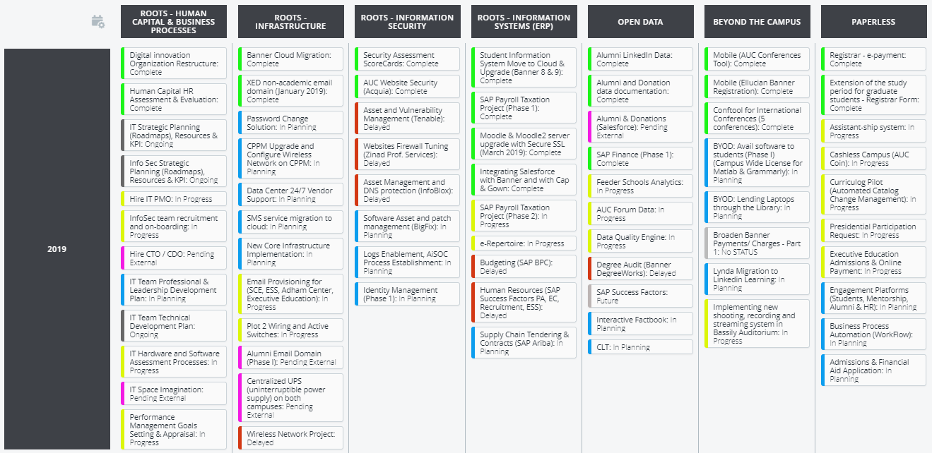
2019 ROADMAP
Roadmaps as our planning methodology

Slide 16
DISCUSSION & QUESTIONS
Strategy Management & Digital Innovation

Slide 17
YOU
The American University in Cairo | Strategy Management & Digital Innovation

