Slide 1
School of Global Affairs & Public Policy (GAPP) Business Plan 2020-2022

Slide 2
For Marco Strategic Objectives for GAPP Adopted on the Occasion of the Tenth Anniversary
Update and Contemporize the Quality of Academic Outputs
(Review\ Modernize\Add)
Expand GAPP’s Undergraduate Footprint
Establish GAPP as a Regional Hub for Global Affairs and Determine its Unique Niche
Particular Attention on Upgrading Two of its Center
Middle East Studies Center (MESC)
American Studies and Research Center (CASAR)

Slide 3
Table of Contents
01
04
Mission, Vison and Values
Key Achievements 2018-2019
02
05
SWOT Analysis
Strategic Plan 2020-2022
03
06
Organizational Structure
Questions & Discussion

Slide 4
Mission
Vision
Values
Prepare graduates to take the lead in shaping the future of their nations and the world at large, with a strong belief in the complementarity of international and domestic affairs, an unwavering commitment to ethics and the rule of law, as well as a belief in the unique role the media plays in shaping public policies.
Establish the premier School of Global Affair and Public Policy in the Middle East and Africa, graduating highly skilled and knowledgeable professionals capable of quality decision-making on matters of public concern domestically, regionally and globally.
Integrity
Objectivity
Freedom of Speech
Global Complementarity

Slide 5
SWOT Analysis
S
W
STRENGTHS
WEAKNESSES
Location of the School at AUC in Egypt at the crossroads of 3 continents;
Hands on experience and interdisciplinary approach.
Highly qualified and diverse faculty.
- Qualified and committed staff;
- Diverse Egyptian and foreign student body;
- Generous Fellowship programs at the graduate level.
- Academic & research units are in dispersed locations on campus;
- A number of programs are not internationally accredited;
Some of the master's degrees offered are not yet accredited by the Supreme Council of Universities.
Volatility of enrollment numbers;
Balancing teaching, research & service is a challenge for faculty members, especially those who want to produce high quality research or publish in tier one journals;
OPPORTUNITIES
THREATS
-Increasing demand for programs offered by the school;
-Growing focus on global affairs issues regionally;
-Increasing internship opportunities for graduates;
-Increasing research demand in disciplines offered at school
-Producing more research & research publications;
-Opportunity for more fundraising for fellowships;
-Opportunity for networking with GAPP alumni;
-Opportunity for communicating policy advice to decision makers since most of our students who are active in the public domain.
- Security concerns in the Middle East;
- High tuition fees in comparison to other Universities in Egypt
- Difficulty in recruiting students from some regions due to language barrier;
- Potential and existing competition regionally and internationally;
O
T

Slide 7
Key Achievements 2018-2019
Review of Academic Output
Increased Grants
On the occasion of GAPP 10th anniversary, academic units undertook the following:
- A self-assessment and review of graduate Programs as well as undergraduate majors & minors.
- Review of curricula & course material offered in these courses.
- Updated & introduced new courses and programs (Ex: IGWS minor, Global Affairs Graduate Diploma, Adham Center professional diploma)
Maintained International and SCU accreditation.
GAPP is working on determining its niche
GAPP is working on how best to teach Global Affairs.
- Grants -2,451,622 $ in 2018-2019.
Wider Outreach &Visibility
- GAPP has expanded its public outreach domestically, regionally & globally through its Tahrir Dialogue Series and the Cairo Review of Global Affairs as well as updating its flagship publications such as Arab Media and Society (AMS) and establish a Public Policy Hub. AMS has been included in the Scopus index.
Increase in the number of conferences.
GAPP Executive Education is working on the Leadership for Government Excellence (LGE) along the School of Business. LGE is a tripartite program between the Ministry of Planning, Monitoring and Administrative Reform (MoPMAR), the American University in Cairo (AUC), and King’s College London (KCL).
Increased Gifts and Fellowships
-Gifts & Endowments has increased from 4,216,850$ in 2009 to 12,713,900 $ in 2018.
-Youssef Jameel fellowship covers more academic units.
-Annual funding for one fellowship (or two 50%) provided by Al Qalaa Foundation to study the MGA program by a junior diplomat(s) of the MoFA.
-Potential 1 million endowment from Boutros Ghali family.
Notes:
Needs to be compiled from the SMIE wall of fame page

Slide 8
For Marco Strategic Objectives for GAPP Adopted on the Occasion of the Tenth Anniversary
Update and Contemporize the Quality of Academic Outputs
(Review\ Modernize\Add)
Expand GAPP’s Undergraduate Footprint
Establish GAPP as a Regional Hub for Global Affairs and Determine its Unique Niche
Particular Attention on Upgrading Two of its Center
Middle East Studies Center (MESC)
American Studies and Research Center (CASAR)

Slide 9
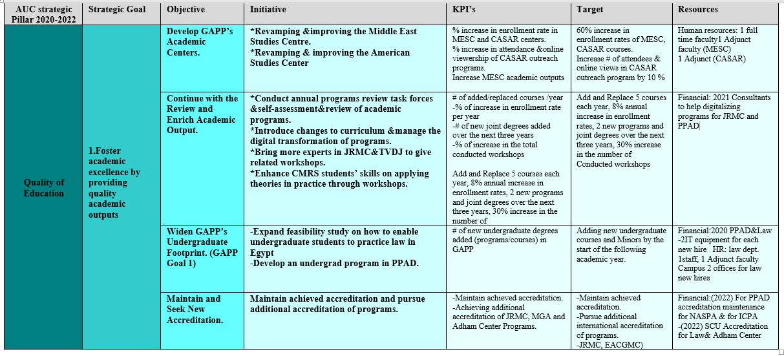
Strategic Plan 2020-2022

Slide 10
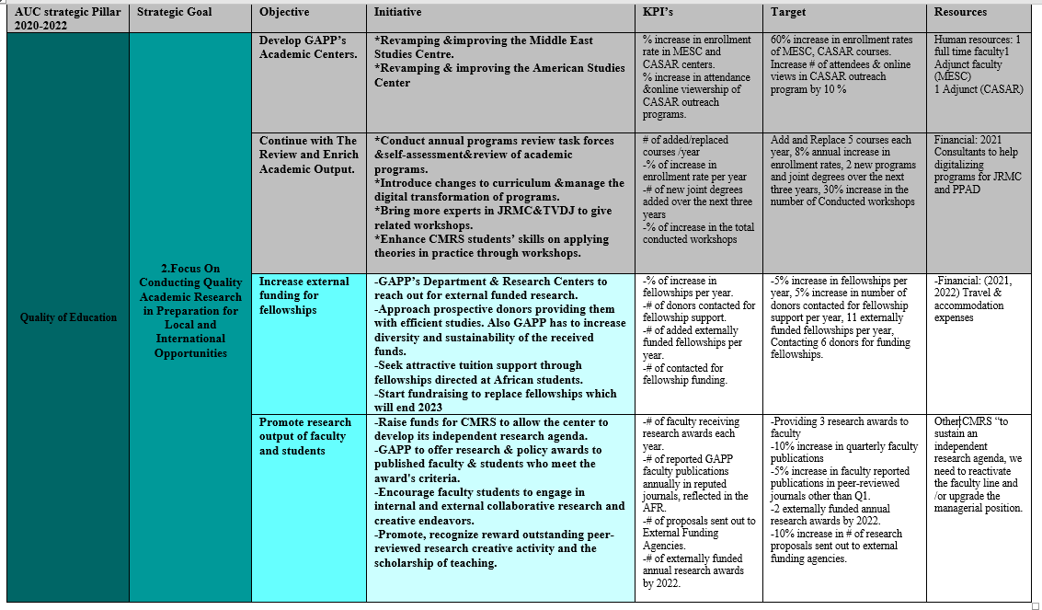
Strategic Plan 2020-2022

Slide 11
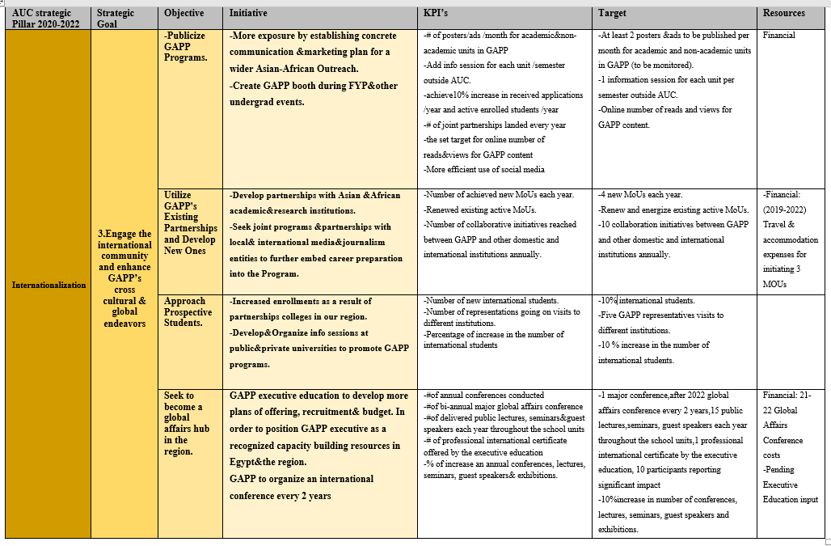
Strategic Plan 2020-2022

Slide 12
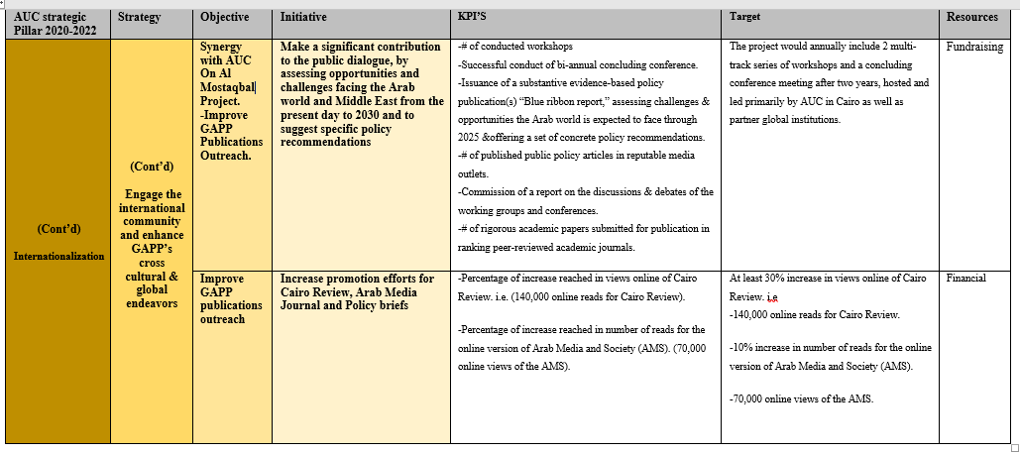
Strategic Plan 2020-2022

Slide 13
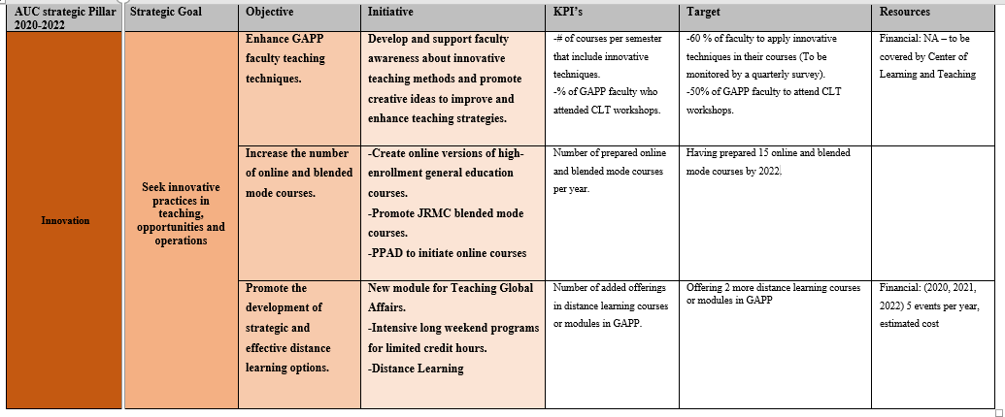
Strategic Plan 2020-2022

Slide 14
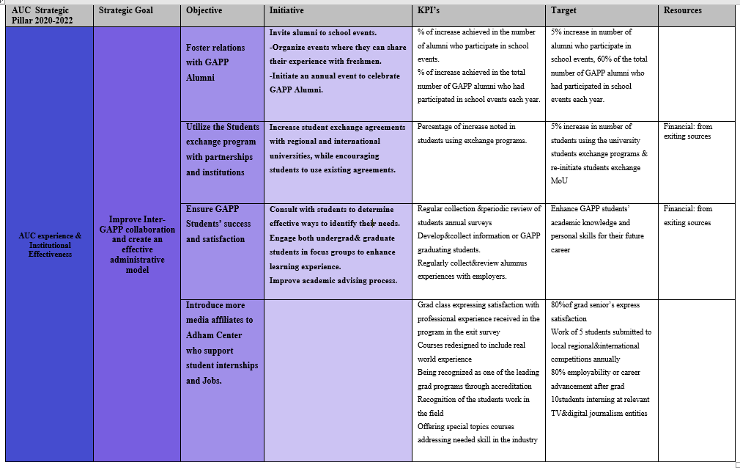
Strategic Plan 2020-2022

Slide 15
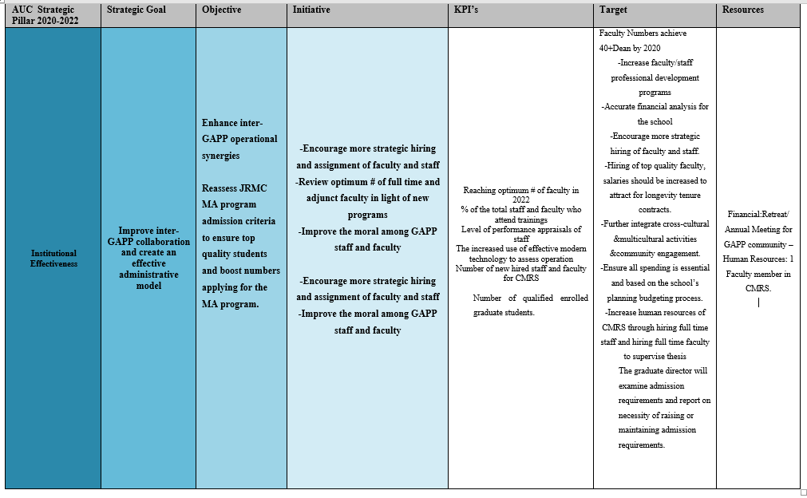
Strategic Plan 2020-2022

Slide 16
DISCUSSION & QUESTIONS

